Slide 1
16N
60⁰
11N
40
30⁰
45⁰
40
8N
9N

Slide 2
First we want to know the horizontal and vertical components
Let’s start with the 16N force
16N
60⁰
11N
40
30⁰
45⁰
40
8N
9N

Slide 3











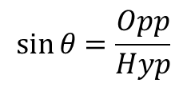
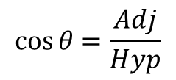

$$\sin{θ}=\frac{Opp}{Hyp}$$
$$\sin{60°=\frac{y}{16}}$$
$$0.866=\frac{y}{16}$$
$$y$$
16N
$$13.86N$$
$$y=0.866×16$$
60⁰
$$y=13.86N$$
$$x$$
$$8N$$
$$\cos{θ}=\frac{Adj}{Hyp}$$
$$\cos{60°}{=\frac{x}{16}}$$
$$0.5=\frac{x}{16}$$
$$x =0.5×16$$
$$x=8N$$

Slide 4


$$13.86N$$
16N
40
60⁰
$$8N$$
40

Slide 5


$$13.86N$$
16N
11N
60⁰
$$8N$$
40
30⁰
45⁰
40
8N
9N

Slide 6
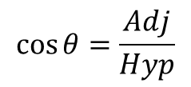
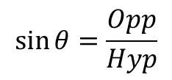












$$\sin{θ}=\frac{Opp}{Hyp}$$
$$\sin{45°=\frac{y}{8}}$$
$$x$$
$$0.866=\frac{y}{8}$$
$$5.66N$$
$$y$$
45⁰
$$y=0.866×8$$
$$5.66N$$
8N
$$y=5.66N$$
$$\cos{θ}=\frac{Adj}{Hyp}$$
$$\cos{45°}{=\frac{x}{8}}$$
$$0.866=\frac{x}{8}$$
$$x =0.866×8$$
$$x=5.66N$$

Slide 7




$$13.86N$$
11N
$$8N$$
$$5.66N$$
45⁰
$$5.66N$$
40
8N
30⁰
40
9N

Slide 8


$$13.86N$$
11N
$$8N$$
40
$$5.66N$$
45⁰
30⁰
40
$$5.66N$$
8N
9N

Slide 9


$$x$$
30⁰
$$y$$
9N

Slide 10










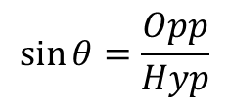
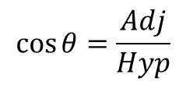

$$\cos{θ}=\frac{Adj}{Hyp}$$
$$\cos{30°}{=\frac{x}{9}}$$
$$0.866=\frac{x}{9}$$
$$\sin{θ}=\frac{Opp}{Hyp}$$
$$x =0.866×9$$
$$\sin{30°=\frac{y}{9}}$$
$$x=7.79N$$
$$7.79N$$
$$x$$
30⁰
$$0.5=\frac{y}{9}$$
$$y$$
9N
$$4.5N$$
$$y=0.5×9$$
$$y=4.5N$$

Slide 11



$$13.86N$$
11N
$$8N$$
$$7.79N$$
30⁰
$$4.5N$$
40
9N
$$5.66N$$
40
$$5.66N$$

Slide 12




$$13.86N$$
11N
$$8N$$
40
$$5.66N$$
$$7.79N$$
30⁰
40
$$4.5N$$
$$5.66N$$
9N

Slide 13


$$13.86N$$
11N
$$8N$$
40
$$5.66N$$
$$7.79N$$
40
$$4.5N$$
$$5.66N$$

Slide 14
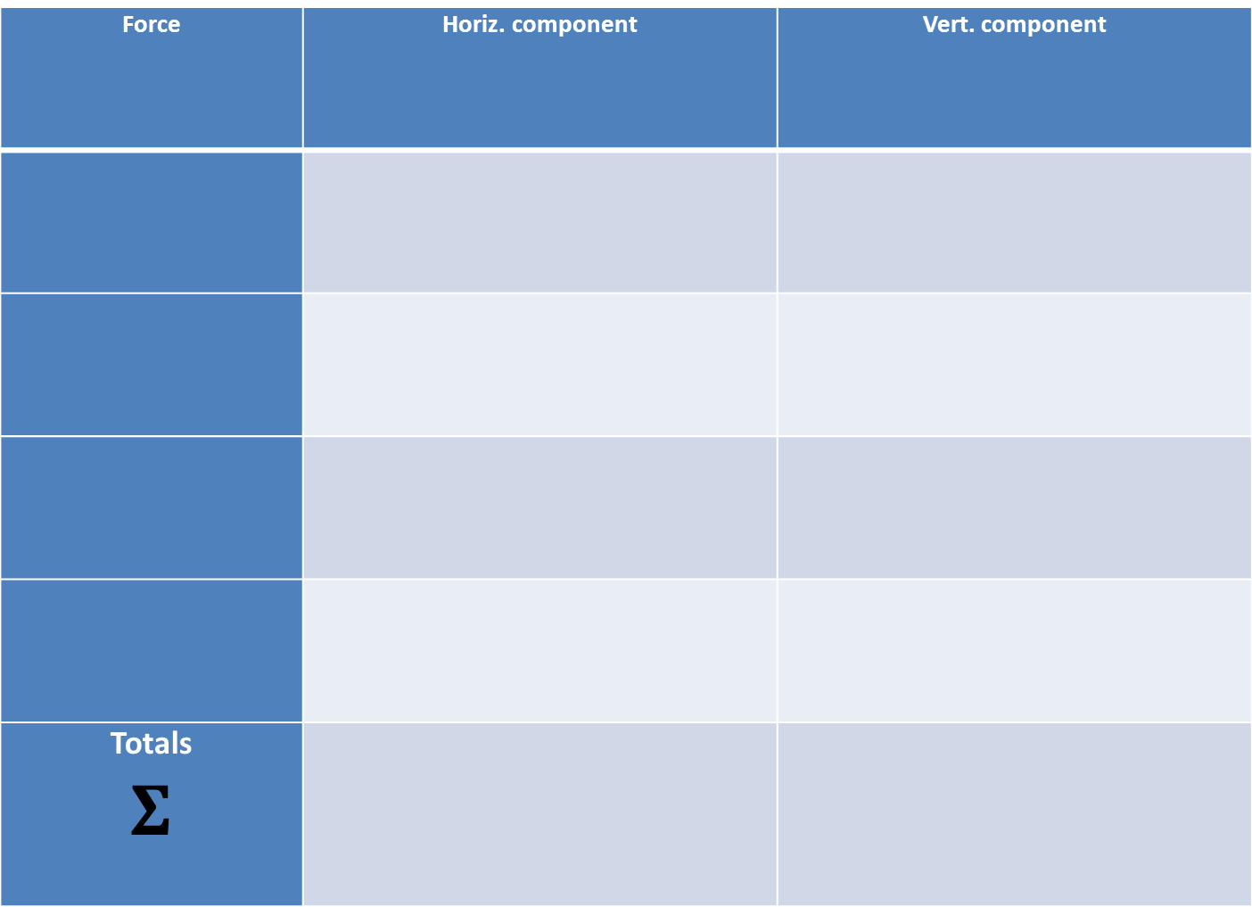



Now it’s time to sum the forces. For equilibrium up and down must be equal and left and right must be equal. Remember, forces down and forces left will have a negative value.
Force | Horiz. component | Vert. component
Totals $$Σ$$
$$13.86N$$
11N
16N
11N
60⁰
$$8N$$
40
30⁰
9N
$$5.66N$$
$$7.79N$$
45⁰
8N
40
$$4.5N$$
$$5.66N$$
5.14N
3.69N

Slide 15
Applaud NOW

Slide 16
Part 2
Find The equilibrant
This is the force which is equal and opposite to the resultant.
So, first we need to find the resultant.
Which we can do because we have just sat through some of the most epic powerpoint slides
EVER
which helped us calculate resultant horizontal and vertical forces. We can use this information and some Pythagoras to calculate the resultant magnitude AND direction.

Slide 17

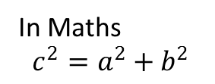


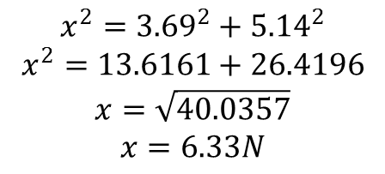
Pythagoras says ‘The square on the hypotenuse is equal to the sum of the squares on the other two sides OR….
A + B = C
C
In Maths
$$c^{2}=a^{2}+b^{2}$$
$$x$$
A
3.69N
$$x^{2}={3.69}^{2}+{5.14}^{2}$$
$$x^{2}=13.6161+26.4196$$
$$x=\sqrt{40.0357}$$
$$x=6.33N$$
$$θ$$
B
5.14N
We can also, with a little trig, find the angle of the resultant.
We know all three sides so Sine, Cosine or Tangent can be used.
$$\tan{θ =\frac{Opp}{Adj}}$$
$$\tan{θ =\frac{3.69}{5.14}}$$
$$\tan{θ =0.718}$$
$$\tan^{−1}{0.718=θ}$$
$$θ=35.73°$$
The resultant then is 6.33N at 35.73° AC from the horizontal (up and right). The equilibriant must be equal and opposite so 6.33N ant 35.73° down and to the left

Slide 18
Now for the fun bit.
We have summed the up and the down, the left and the right and have found the magnitude and direction of the resultant force. Our task now is to find out WHERE in the box that force acts. To do this we use moments.
The definition of a moment is…….
The force multiplied by the perpendicular distance. Lets take moments about the top left corner.
At this point let us take a look at our square and our forces and cry quietly because we can press next for the difficult way as we don’t know the perpendicular distance for the 8N and 9N forces on the bottom. Or we can do it the easy way…

Slide 19
Taking moments about A;
the 11N force and the 16N force both pass through point A and so the moments would be 11N x 0m and 16N x 0m so we can ignore them. This leaves the 9N and 8N forces on the bottom of the square.
16N
60⁰
A
11N
40
30⁰
45⁰
40
8N
9N
Lets take each of these in turn and find the perpendicular distances, and then calculate the moments. We will start with the 9N

Slide 20
The perpendicular distance we are looking for is this RED LINE wot has just appeared.
‘But’ I hear you ask, ‘how DO we calculate the yellow line??’
But we can calculate this length
Currently we don’t know any of the distances for this triangle
And subtract this
16N
60⁰
11N
To make life a little simpler (remember this is just a diagram, NOT TO SCALE)
40
30⁰
45⁰
40
8N
9N

Slide 21

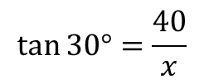

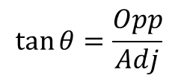


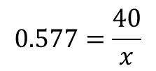
$$\tan{θ}=\frac{Opp}{Adj}$$
This is our triangle.
It’s right angled.
We want to find the length of the yellow slide.
We know one side and one angle.
WE CAN USE TRIG!!!
I’m glad you asked
$$\tan{30°}{=\frac{40}{x}}$$
29.3mm
$$69.3mm$$
$$x$$
$$0.577=\frac{40}{x}$$
$$x =\frac{40}{0.577}$$
$$x=69.3mm$$
40
30⁰
30⁰
40
And 69.3 – 40 = 29.3mm

Slide 22
29.3mm
$$69.3mm$$
30⁰
40
40

Slide 23
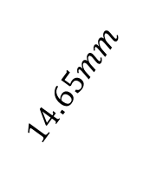


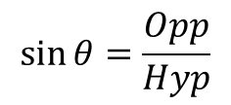



$$\sin{θ}=\frac{Opp}{Hyp}$$
$$\sin{30°}{=\frac{x}{29.3}}$$
29.3mm
$$0.5=\frac{x}{29.3}$$
30⁰
$$x =0.5×29.3$$
$$x=14.65mm$$
$$14.65mm$$
$$x$$

Slide 24

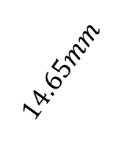



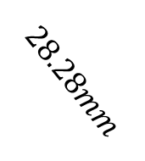

$$\sin{θ}=\frac{Opp}{Hyp}$$
This becomes our triangle
This is the perpendicular distance
$$\sin{45°}{=\frac{x}{40}}$$
$$0.707=\frac{x}{40}$$
$$x =0.707×40$$
$$14.65mm$$
$$28.28mm$$
$$x=28.28mm$$
$$x$$
$$14.65mm$$
40
45⁰
30⁰
45⁰
40
8N
And now for the 8N force

Slide 25
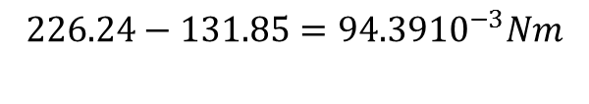
Now for equilibrium CW moment must equal ACW moments, but that’s obviously not true here so lets assume ACW’s are negative, subtract one from the other and get a resultant moment
Now we have found the perpendicular distances we can calculate the moments which will give us the POSITION of the resultant and hence, the position of the equilibrant.
So, taking moments
Right, almost there!!!!
$$9N×14.65×{10}^{−3}m=131.85×{10}^{−3}Nm$$
$$8N×28.28×{10}^{−3}m=226.24×{10}^{−3}Nm$$
$$226.24−131.85=94.39{10}^{−3}Nm$$

Slide 26

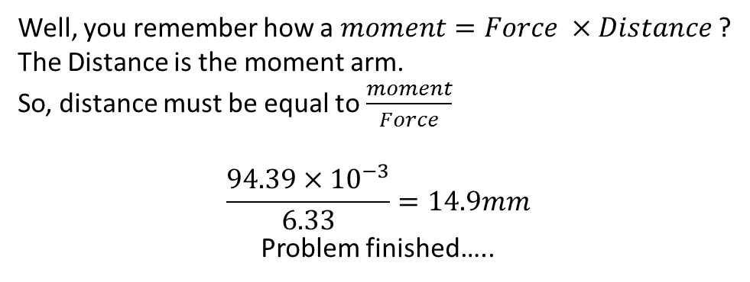
But what I hear you ask is a moment arm…
Well, you remember how a $moment=Force ×Distance$?
The Distance is the moment arm.
So, distance must be equal to $\frac{moment}{Force}$
$$\frac{94.39×{10}^{−3}}{6.33}=14.9mm$$
Problem finished…..
$$Reultant moment=94.39{×10}^{−3}Nm$$
$$Resultant Force=6.33N at 35.73° up$$
$and right from the horizontal$.
We can now find the moment arm of the resultant.
EH???
$$226.24−131.85=94.39{10}^{−3}Nm$$

Slide 27

$Resultant Force=6.33N at 35.73° up and right from the horizontal$.
$$35.73°$$
14.9
And the moment arm is 14.9mm, which means that that is the distance perpendicular from the reaction to A where we took our moments.

Slide 28
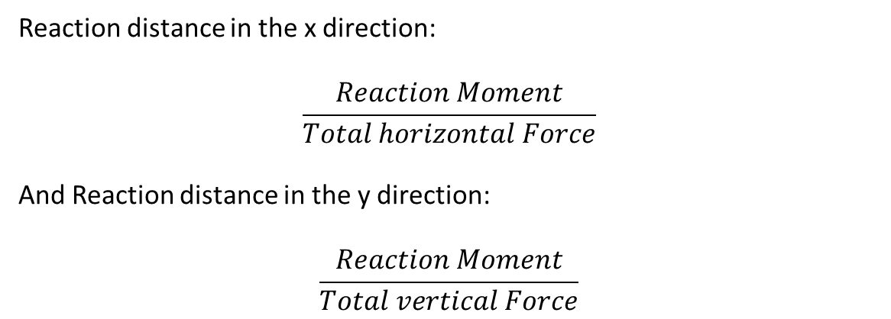
We can check this by finding the horizontal and vertical distances from A the the force passes through.
Reaction distance in the x direction:
$$\frac{Reaction Moment}{Total horizontal Force}$$
And Reaction distance in the y direction:
$$\frac{Reaction Moment}{Total vertical Force}$$

Slide 29




The easy way.
We have resolved our forces into vertical and horizontal components, so lets use these to find the moments about A
We can make life simpler by removing the forces which pass through A.
$$13.86N$$
A
11N
$$8N$$
40
$$5.66N$$
$$7.79N$$
40
$$4.5N$$
$$5.66N$$

Slide 30


So the CW moments
must equal the anticlockwise moments.
A
40
$$5.66N$$
$$7.79N$$
40
$$4.5N$$
$$\left(5.66×40×{10}^{−3}\right)+\left(4.5×40×{10}^{−3}\right)$$
$$=\left(7.79×40×{10}^{−3}\right)$$
$$406.4×{10}^{−3}=311.6×{10}^{−3}$$
Lets take ACW moments as negative so:
$$406.4×{10}^{−3}−311.6×{10}^{−3}=94.8×{10}^{−3}$$

Slide 31
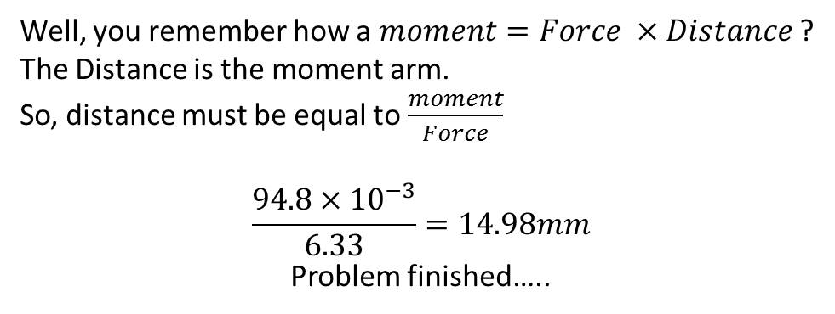

But what I hear you ask is a moment arm…
Well, you remember how a $moment=Force ×Distance$?
The Distance is the moment arm.
So, distance must be equal to $\frac{moment}{Force}$
$$\frac{94.8×{10}^{−3}}{6.33}=14.98mm$$
Problem finished…..
$$Reultant moment=94.39{×10}^{−3}Nm$$
$$Resultant Force=6.33N at 35.73° up$$
$and right from the horizontal$.
We can now find the moment arm of the resultant.
EH???
$$406.4×{10}^{−3}−311.6×{10}^{−3}=94.8×{10}^{−3}$$

Slide 32

$Resultant Force=6.33N at 35.73° up and right from the horizontal$.
$$35.73°$$
14.9
And the moment arm is 14.98mm, which means that that is the distance perpendicular from the reaction to A where we took our moments.

